Slide 1
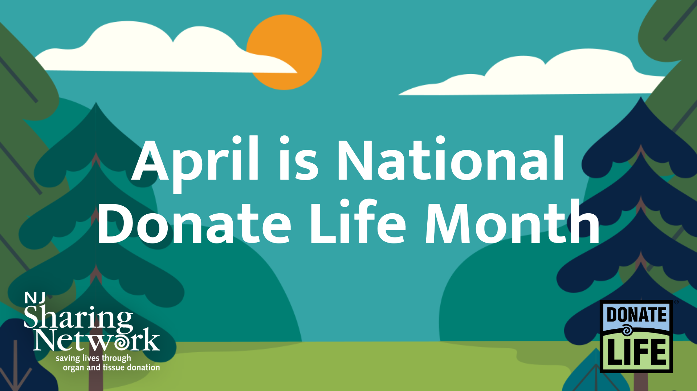

Slide 2
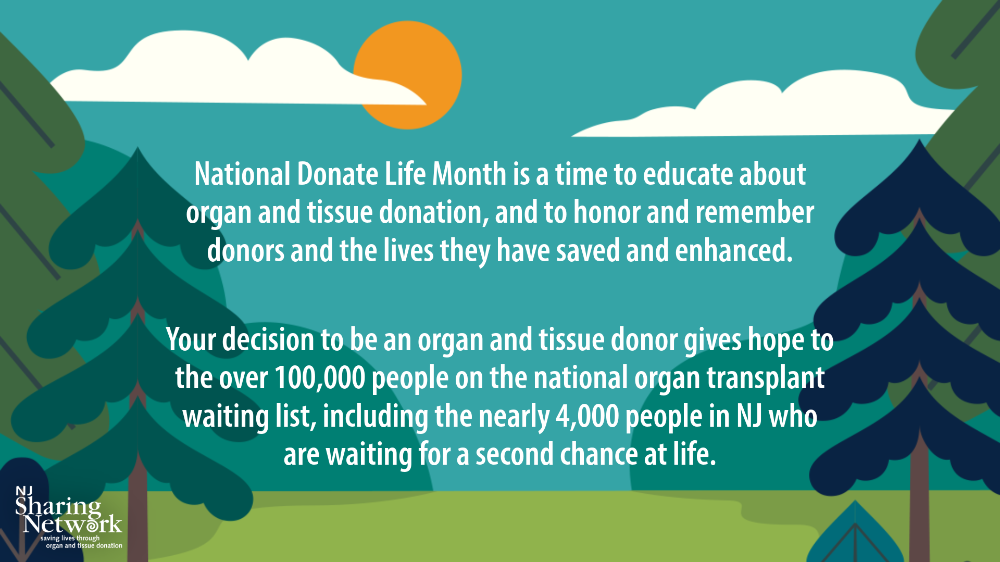

Slide 3
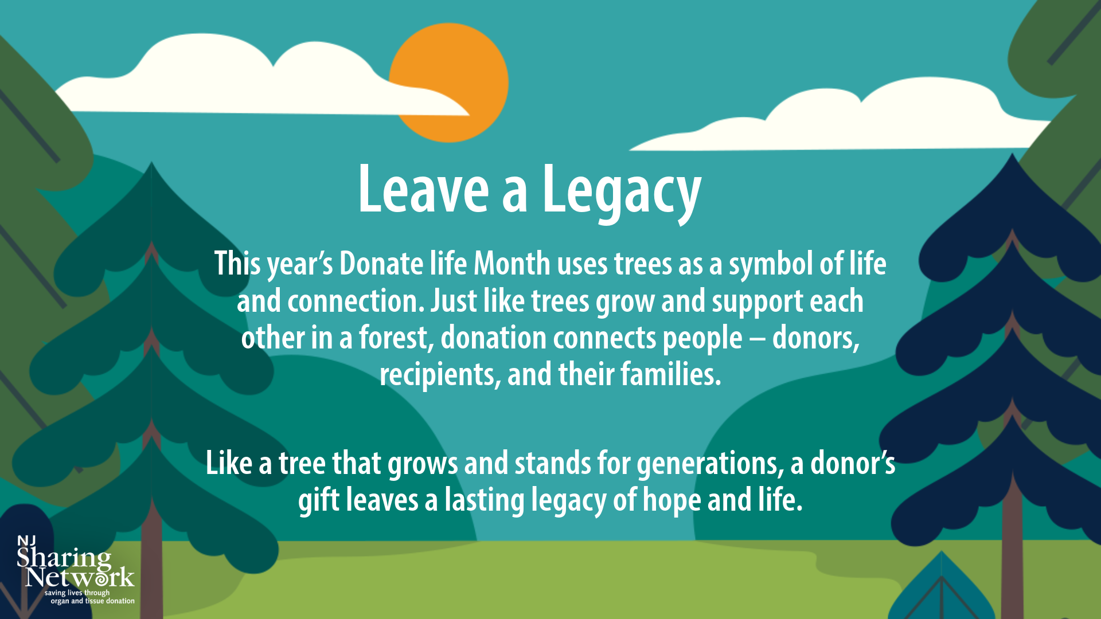

Slide 4
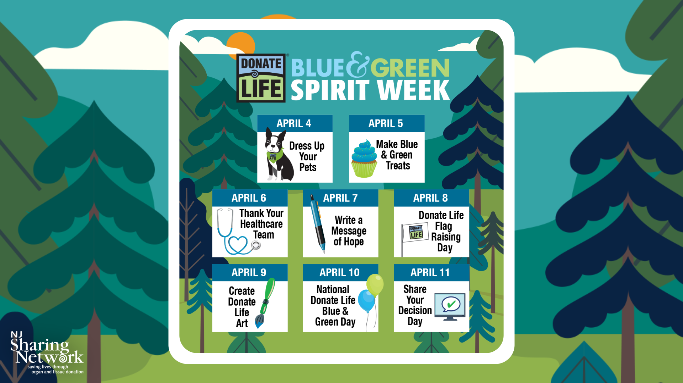

Slide 5


Slide 6
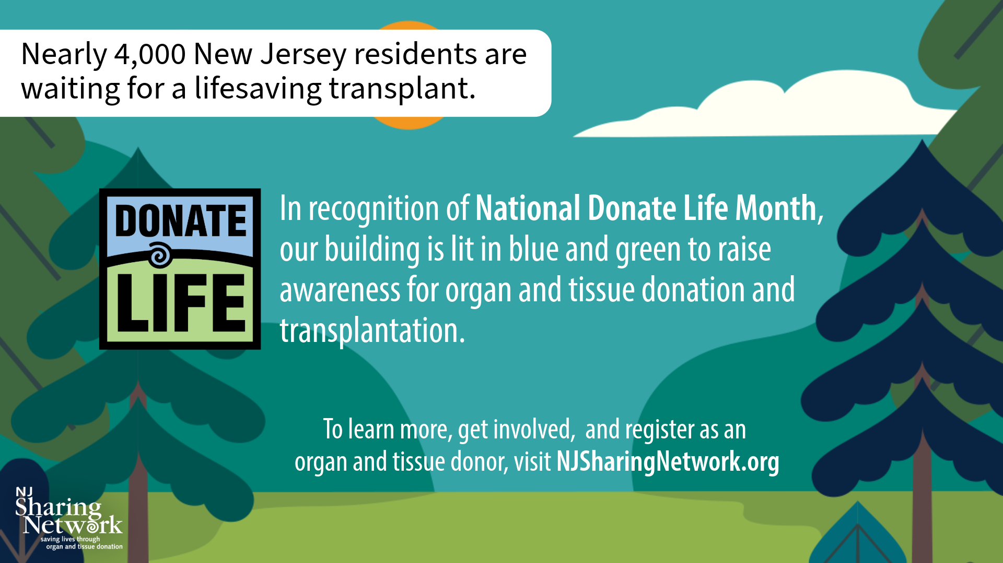

Slide 7

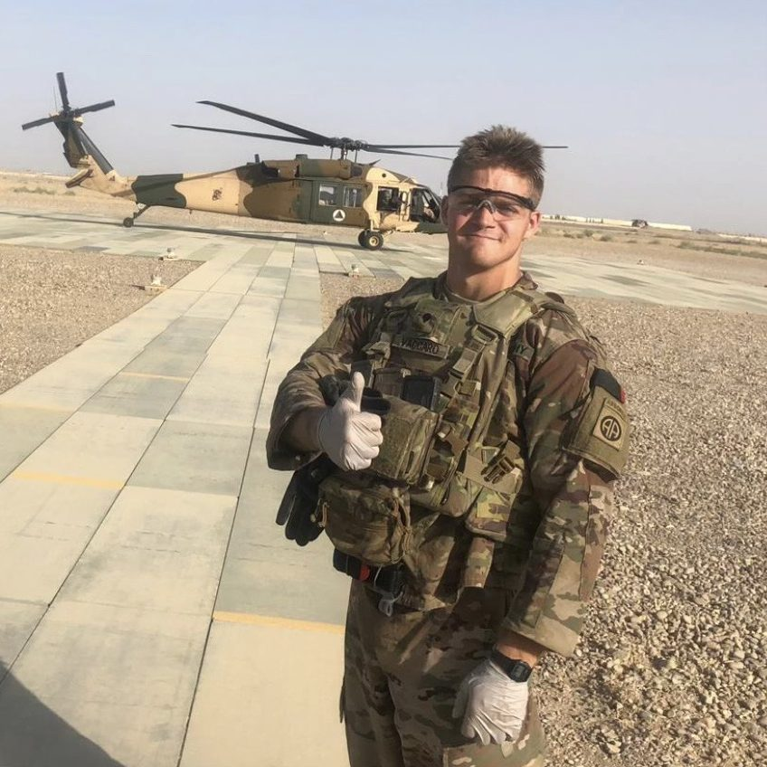


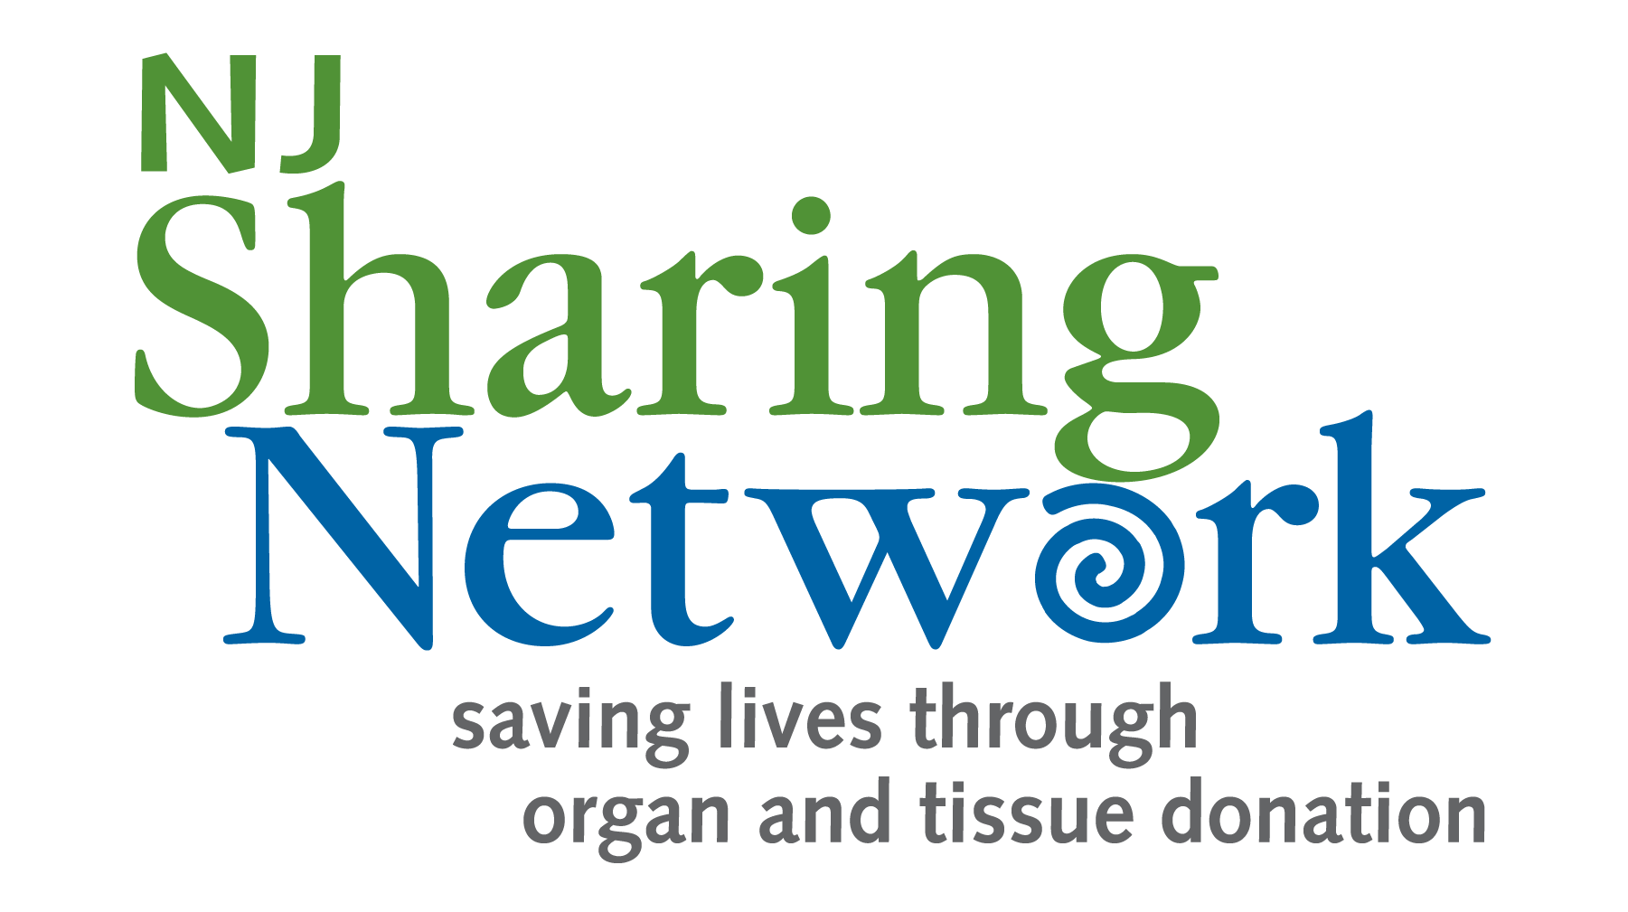
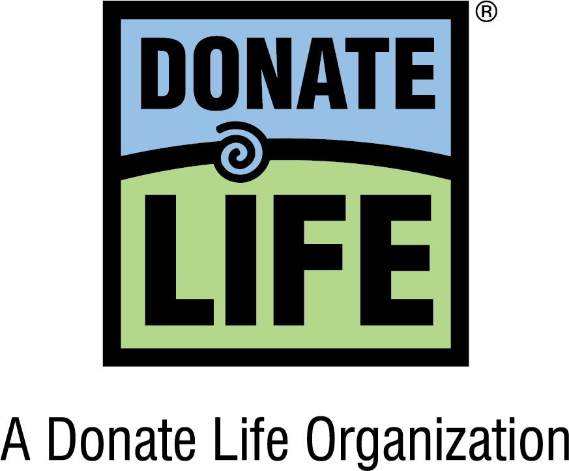
Stories of Hope
Dennis Vaccaro
Organ Donor
U.S. Army Sergeant Dennis Vaccaro lived a life of purpose and bravery. A dedicated soldier, son, husband, and friend, Dennis embodied selflessness and service, values that endured beyond his time on earth.
Dennis was an airborne combat medic with the 82nd Airborne Division, including a tour in Afghanistan. Known for his commitment to his fellow soldiers, he often went above and beyond, even volunteering his leave time to ensure a friend could be with family.
“Dennis had a way of always putting others first, even in the smallest things,” said his mother, Teri Vaccaro. “That’s who he was—selfless, thoughtful, and always looking out for others.”
Dennis’s life was cut short in a motorcycle accident, but his dedication to helping others continued through his final act of service as an organ donor. His heart, kidneys, and liver were transplanted to save four lives in NJ, NY, and Penns.
Dennis left a proud legacy of love, bravery, and generosity. The lives he saved bring his family comfort, knowing his spirit of giving continues.
April is National Donate Life Month
Register as an organ and tissue donor at NJSN.org

Slide 8
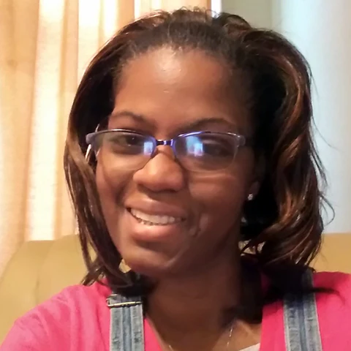
Stories of Hope
LaVise McCray
Kidney Transplant Recipient
LaVise McCray's life changed when she received a kidney transplant at Hackensack University Medical Center. Now, the retired Jersey City Public School teacher is on a mission to spread the message of hope through organ and tissue donation.
“I share my kidney transplant journey on social media and with everyone that I meet to inspire others to be a symbol of hope and encourage people to register as organ and tissue donors,” said LaVise.
LaVise's journey to transplant was filled with many triumphs and many challenges, but she never gave up.
“I prayed to God for a miracle,” said LaVise and the call came, ‘Hi LaVise, are you ready?’ I had no clue at first what they were talking about, but the next words changed my life forever. They said, ‘Your kidney is ready.’”
LaVise is filled with gratitude, cherishing each moment, and living life to its fullest. “I am alive today thanks to my amazing medical team, my loving family and friends, and my generous organ donor hero who gave me the gift of life,” said LaVise.
April is National Donate Life Month
Register as an organ and tissue donor at NJSN.org

Slide 9
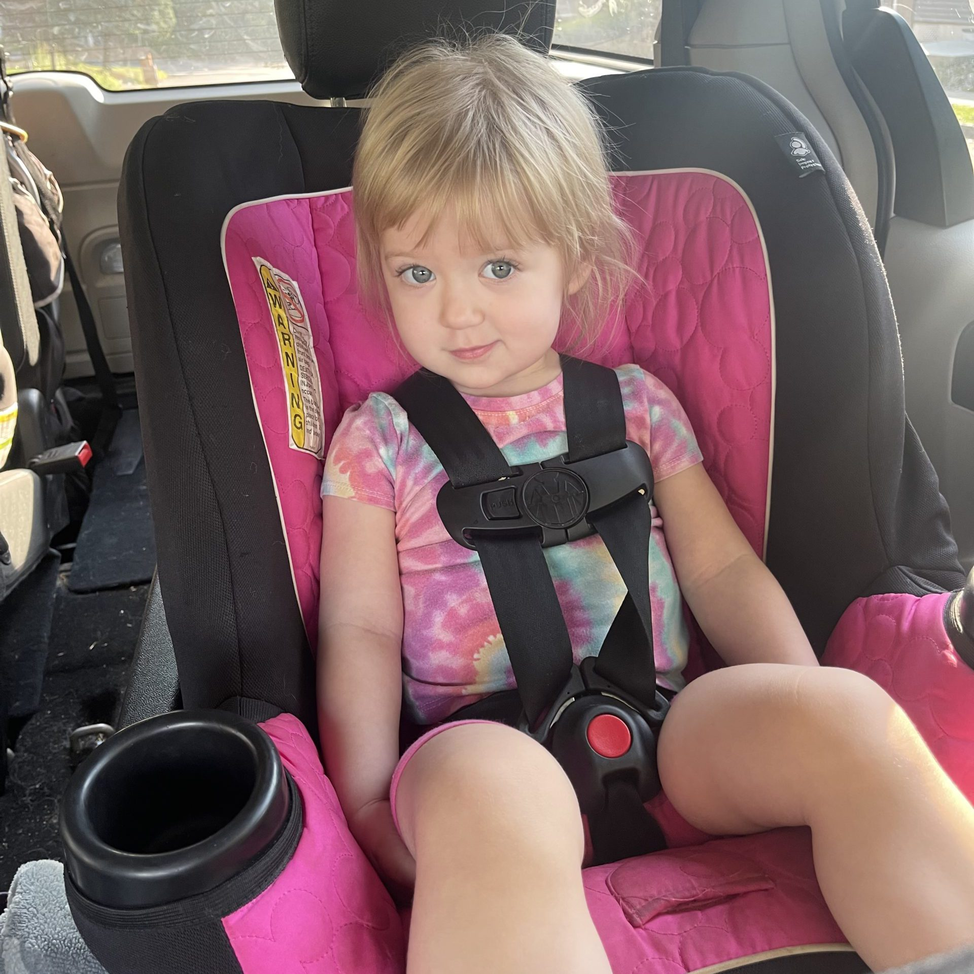
Stories of Hope
Samantha Jillian Chapman
Organ Donor
Samantha Jillian Chapman was a vibrant three-year-old, whose cheerful nature touched all who knew her. Her donated heart, liver, and kidneys saved the lives of others.
Samantha’s parents, Stefanie and John Chapman, recall how she was her twin brother Owen’s fierce protector, never taking a bottle or snack without making sure he had one too. She also loved her “big bro” Nathan and their mini monster truck rides in their yard.
Stefanie and John have found a source of hope amidst their grief thanks to the miracle of donation and transplantation.
“We immediately realized we wanted to help others live on,” said Stefanie. It wasn’t a difficult decision.”
“Samantha was such a loving and outgoing child. I am sure that when she grew up, she would have said ‘Yes’ to registering as an organ and tissue donor,” said Stephanie. “When her brothers are old enough to understand, they will take pride in knowing that their sister is a hero who gave the gift of life to others.”
April is National Donate Life Month
Register as an organ and tissue donor at NJSN.org

Slide 10
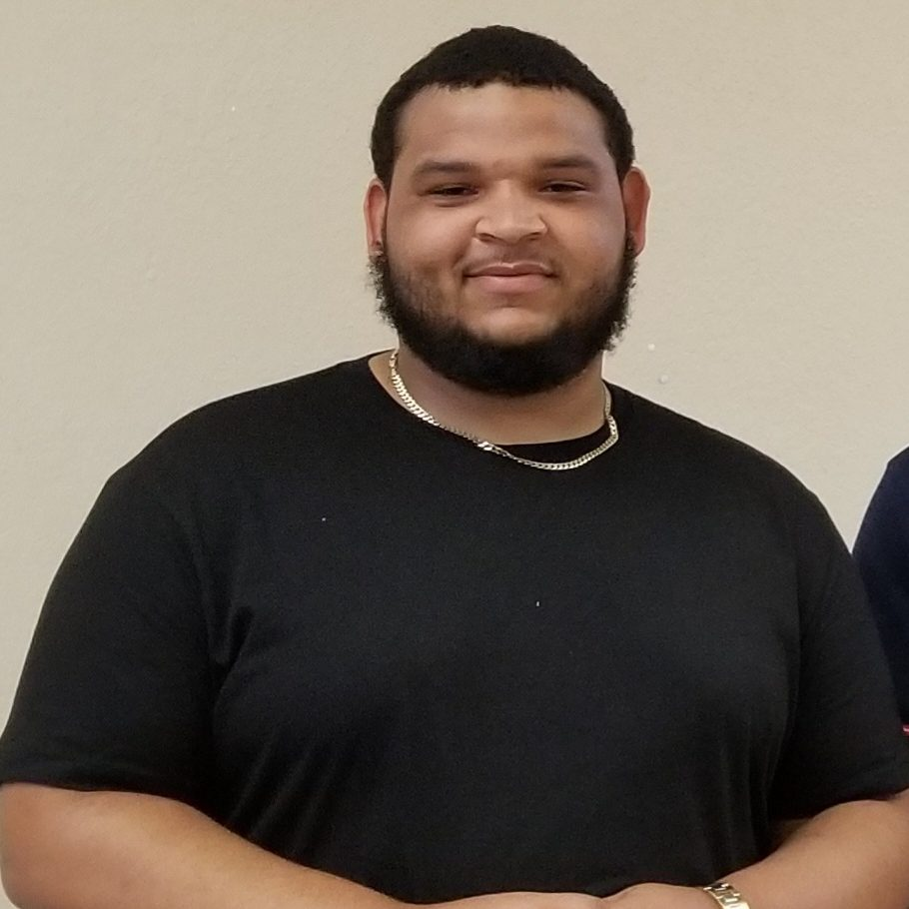
Stories of Hope
Devon Lewis
Organ and Tissue Donor
Devon Lewis, 23, passed away unexpectedly after suffering a severe asthma attack. The beloved son of Karen Lucas and Michael Lewis, Devon graduated from Neptune High School and attended Lincoln Technical Institute where he earned a HVAC certification. His loved ones will never forget his selfless and caring nature.
“Our hearts were broken when we received the devastating news in the hospital that Devon was brain dead due to the loss of oxygen to his brain,” said Karen, Devon’s mother. “Our beloved son was gone but we recognized that Devon had the chance to help others, and we said, ‘yes’ to donation.”
Devon’s heart was successfully transplanted to save the life of a 15-year-old girl, his liver saved a 57-year-old man, and his kidneys saved a 24-year-old man and a 61-year-old man. Devon’s tissue donations also enhanced the quality of life for those suffering from chronic pain and impaired mobility.
“Devon became a hero by saving the lives of others. His spirit and memory will live on forever,” said Karen.
April is National Donate Life Month
Register as an organ and tissue donor at NJSN.org

Slide 11
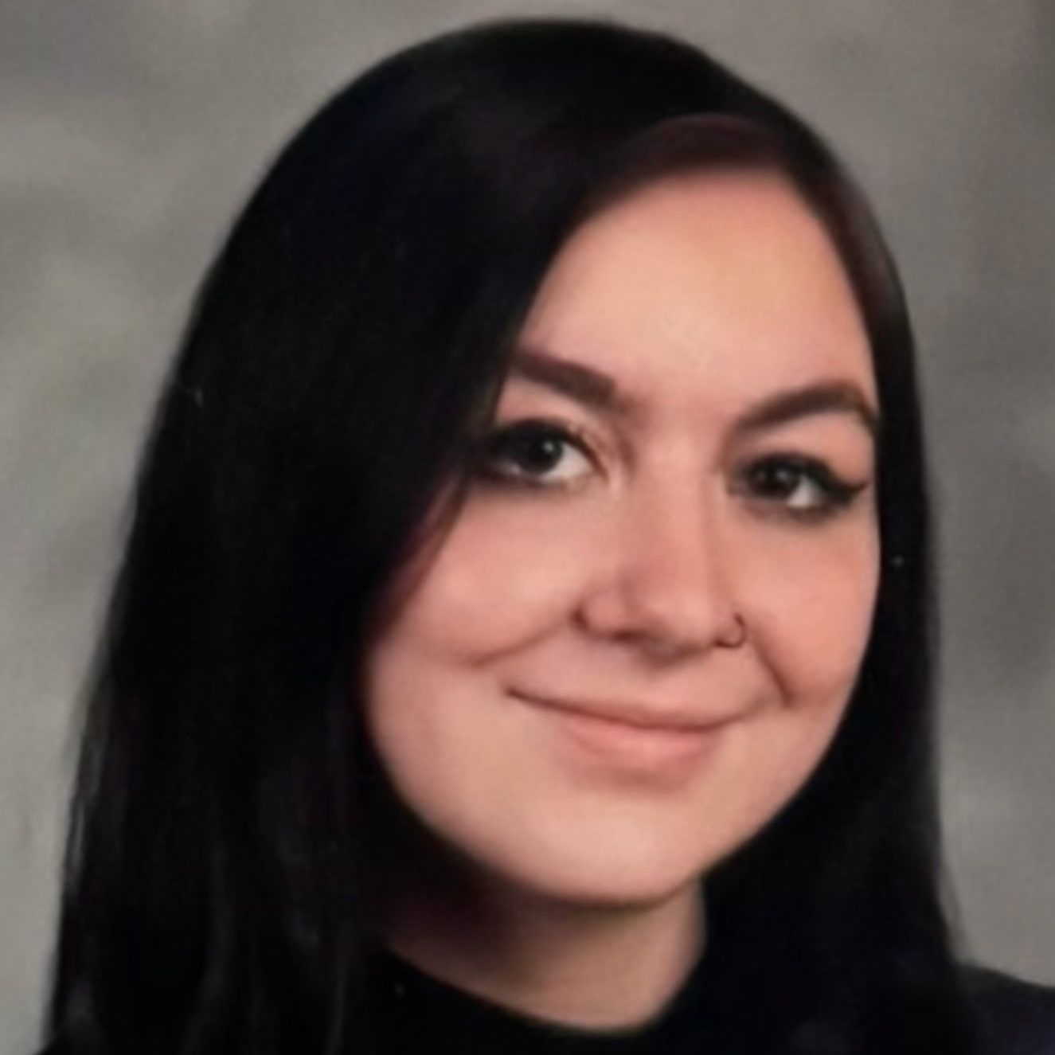
Stories of Hope
Deanna Noelle “Dee Dee” D’Arco
Organ and Tissue Donor
Deanna Noelle “Dee Dee” D’Arco passed away at just 19 years old, following a tragic car accident. A beloved teacher’s assistant Deanna was cherished by her students, remembered for giving the best hugs, and loved by all who knew her. Her vibrant spirit, compassionate nature, love for animals, and dedication to others left a lasting impression on everyone she met.
Deanna’s donated heart, liver, and kidney saved the lives of three people, giving them renewed hope and the chance to create new memories with their loved ones. Additionally, her tissue donations, including skin, bone, tendons, and corneas, offer healing to those in need.
“Deanna has always been a hero to me, and now she can be a hero forever” said her father, Steven D’Arco, “This brings us solace, knowing something positive can come from such an unimaginable loss.”
“We are forever grateful for the support from NJ Sharing Network,” said Steven. “They’ve helped us process our loss and provided a path for hope and healing. Knowing that Deanna’s gifts gave life to others helps ease the pain.”
April is National Donate Life Month
Register as an organ and tissue donor at NJSN.org

Slide 12
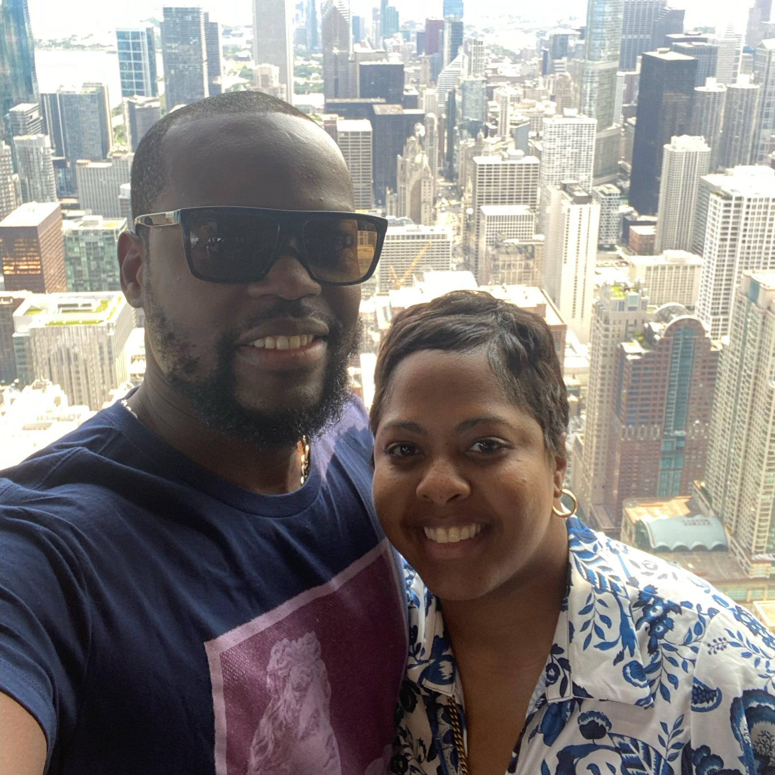
Stories of Hope
Destiny Charles
Kidney Transplant Recipient
Destiny Charles’ journey from battling kidney disorder as a teenager to becoming an ICU nurse at Cooper University Hospital is a story of hope and resilience.
Destiny's health journey began when she was a teenager. At the age of twenty-one, she needed dialysis treatments to keep her alive. Destiny faced the possibility of a lengthy wait for a transplant, but she remained optimistic.
“Dialysis was never easy, and life was hard. I tried to remain positive and live my life as best as I could – even though I often had to carry my dialysis machine around with me in a big box,” said Destiny.
Destiny’s life began to change for the better when her aunt, Pelrique Price, generously donated her kidney as part of a paired kidney exchange program. Destiny’s successful kidney transplant surgery put her on a fast track to full recovery. “I remember feeling lighter and more energized right away, said Destiny.
April is National Donate Life Month
Register as an organ and tissue donor at NJSN.org

