Slide 1
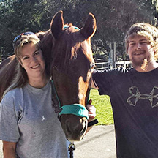
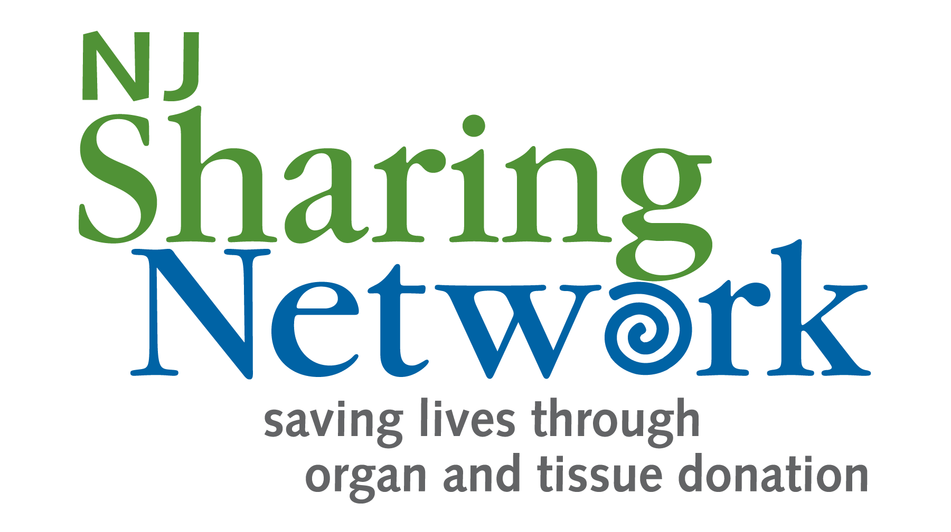
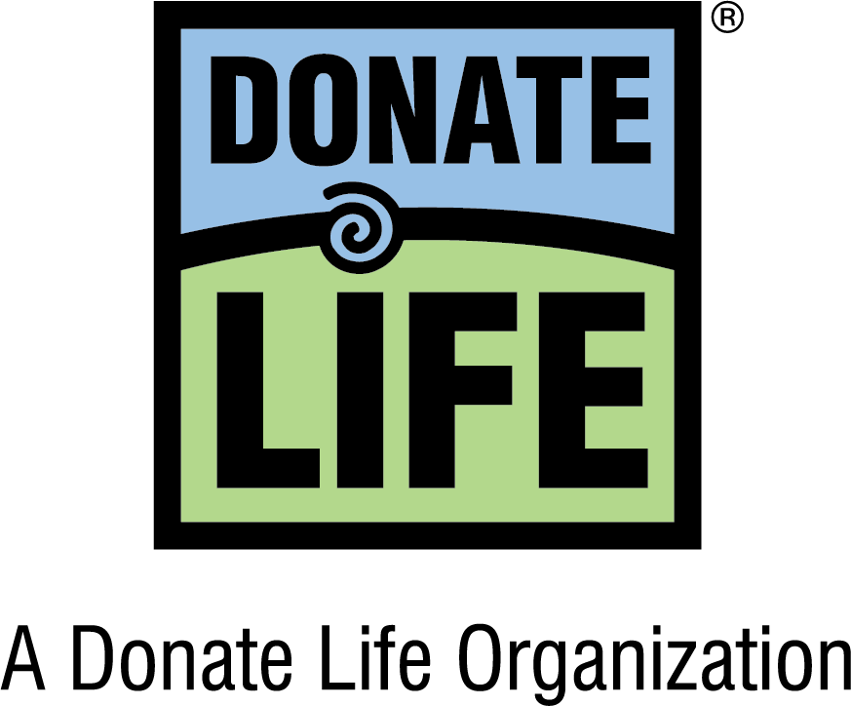
Stories of Hope
Heather Prutzman and Joey Savage Transplant Recipient and Organ Donor Heather, formerly of Newton, faced unbearable loss when her son Joey passed away at the age of 25 due to a tragic car accident. However, it gave her peace to know that a special part of Joey will continue to live on thanks to his selfless decision to register as an organ and tissue donor. Heather was able to meet Jim, the recipient of Joey's heart. As she listened to Joey’s heart beat inside of Jim, she whispered, “I love you buddy always and forever.” In 2019, Heather’s touching story took another amazing turn when she underwent a successful spine surgery that included two pieces of Joey’s donated bones that were a perfect match! “This was Joey’s way of saying ‘Keep going mom, I got your back, you got this,’” said Heather. “I know that Joey is rallying around me so I will never be alone.”
Join the National Donate Life Registry as an organ and tissue donor at NJSharingNetwork.org.

Slide 2
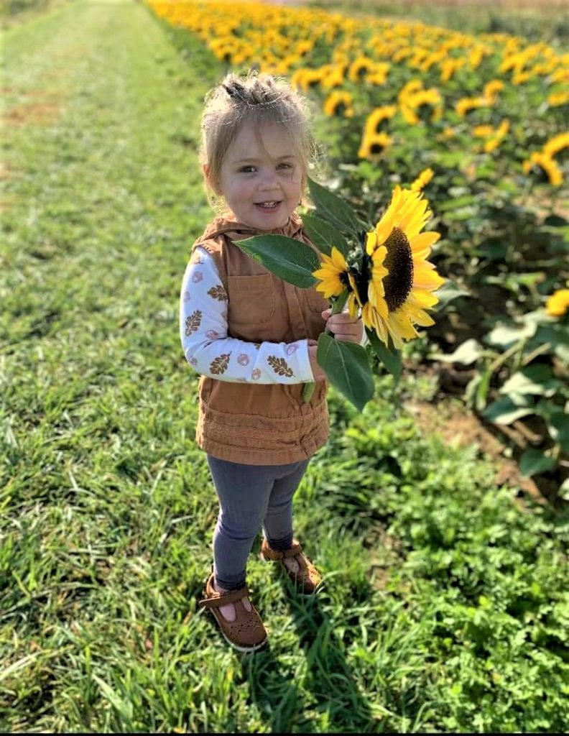
Stories of Hope
Lilyanne “Lily” James Organ Donor
Lieutenant Craig James of Avenel has been overwhelmed by the support he has received from people throughout New Jersey and beyond following the tragic passing of his wife Denise and their three-year-old daughter Lilyanne (Lily) in a tragic motor vehicle accident. Craig says he has found some comfort in knowing that Lily gave the ultimate gift of life to others as an organ donor. Her donated heart and liver saved the lives of two 2-year-old boys. “I want everyone to know that Lily is a hero,” said Craig. “I am amazed that nearly everyone that I speak with says that they have now checked the box to register as donors. It is truly a silver lining that so many lives can be saved and enhanced in the future thanks to Lily.”
Join the National Donate Life Registry as an organ and tissue donor at NJSharingNetwork.org.

Slide 3
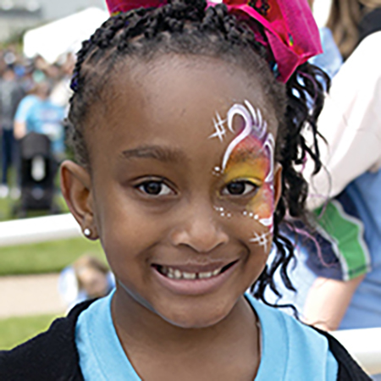
Stories of Hope
Jayla Sorenson Waiting for a life-saving organ transplant
Jayla of Toms River has a disorder known as kidney dysplasia and cystic disease, which has interfered with the development of her kidneys, limiting their ability to filter and clean her blood normally. As a result, she has steadily outpaced her kidneys’ functional capacity as the rest of her has grown from a 2-pound, 2-ounce infant born two months premature, to a vivacious little girl of normal height and weight who likes to dance, play outside, hug and kiss her dad, and master addition and subtraction. But the clock is ticking towards a more critical stage in Jayla’s condition that will eventually involve a pediatric kidney transplant. “Obviously, you don’t want anything to happen to your child,” said James Sorenson, Jayla’s father. “I want her to be able to grow up, to enjoy everything that she, that every child, is supposed to enjoy.”
Join the National Donate Life Registry as an organ and tissue donor at NJSharingNetwork.org.

Slide 4
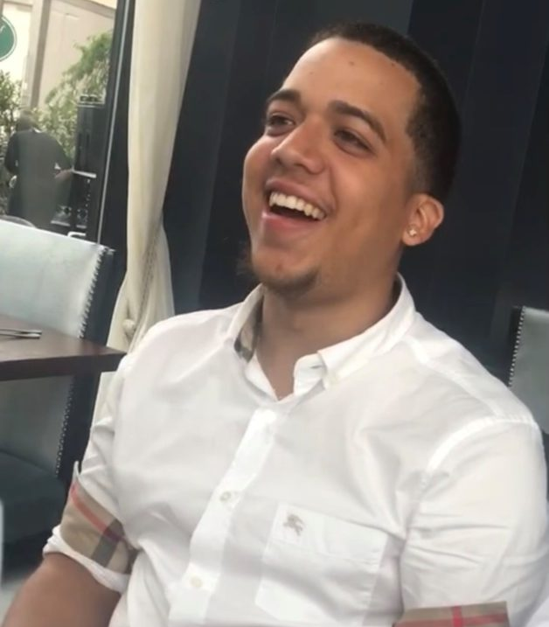
Stories of Hope
Freddy Diaz Villa Organ and Tissue Donor
The family, friends and coworkers of Freddy Diaz Villa all knew whenever they saw him that they would be greeted with his warm smile and usually a great big hug. While he loved music, cooking and basketball, his greatest joy in life came from helping others. On January 25, 2022, Freddy passed away at the age of 23. During Freddy’s final days in the hospital, his mother Lucy struggled with the decision on whether to donate his organs and tissue. Ultimately, Lucy realized that Freddy would want to give the gift of life as his final act of compassion to others. “I had a dream about Freddy, and a feeling came over me that he wanted to give to others now that his time was done here on Earth,” said Lucy. “I am glad that I followed that feeling. I know it would make Freddy happy to know that he helped others.”
Join the National Donate Life Registry as an organ and tissue donor at NJSharingNetwork.org.

Slide 5
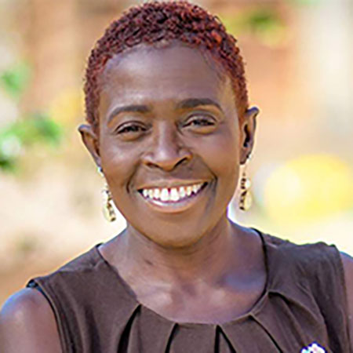
Stories of Hope
Denise Peoples Transplant Recipient
Denise of Newark was diagnosed with a debilitating lung disease despite the fact that she never smoked and had no family history of the condition. After a successful double-lung transplant, she was inspired to educate others about the miracle of organ and tissue donation and transplantation. Today, Denise is a Community Services Manager at NJ Sharing Network, and she works throughout the year to promote their life-saving mission in local schools, faith-based organizations and community associations. “Because of my own transplant, I can share a unique perspective,” said Denise. “My life is fulfilled, and I find purpose every day in helping to spread the word and dispel any myths and misinformation about organ and tissue donation.”
Join the National Donate Life Registry as an organ and tissue donor at NJSharingNetwork.org.

Slide 6
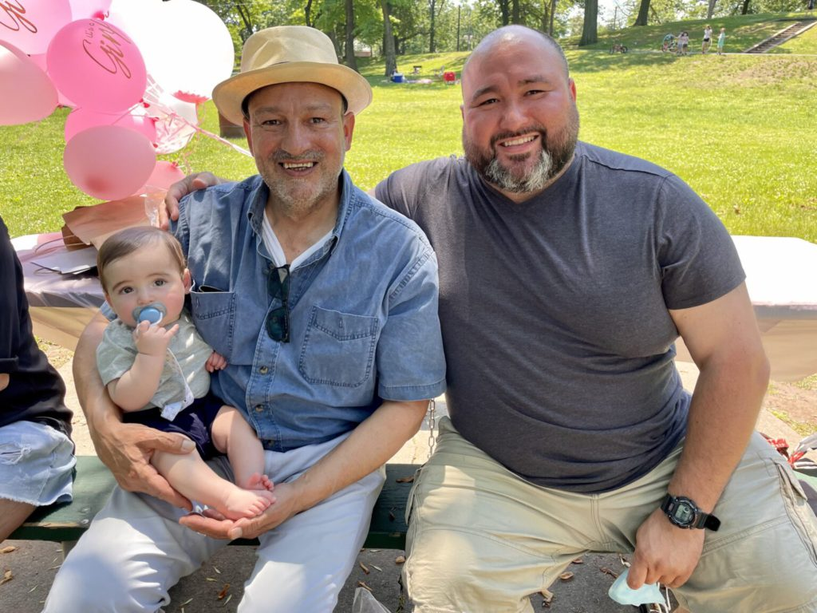
Stories of Hope
Anthony Cruz, Sr. Organ and tissue donor
Residents in and around Jersey City experienced a deep loss when well-known and beloved community activist Anthony Cruz, Sr. (pictured left), 61, passed away. For four decades, Anthony worked tirelessly on community development both inside local government and in the private sector in a variety of organizations and roles, from tenant organizer to nonprofit leader. Anthony’s selfless legacy also lives on as an organ and tissue donor who enhanced the lives of many others. “It was another example of the kind of giving person that he was,” said David Cruz, Anthony’s brother. “Everything he did in his life - personally and professionally - he did it with a great sense of humility and with purpose without needing any accolades. Anthony being a donor hero made us all think, ‘yeah, that would be Anthony.’ They will not make many more like my brother.”
Join the National Donate Life Registry as an organ and tissue donor at NJSharingNetwork.org.

